Slide 1
Coursera project
João Ferreira

Slide 2
Multicultural cities
Amsterdam
London
Los Angeles
Paris
New York City
San Francisco
São Paulo
Singapure
Sydney
Toronto

Slide 3
Business problem
The president of ONU needs to compare the neighborhoods of that cities to understand they are similar or not. In that case i'll compare New York City (used in Module 3), Toronto (used in Module 3), Paris and London.

Slide 4
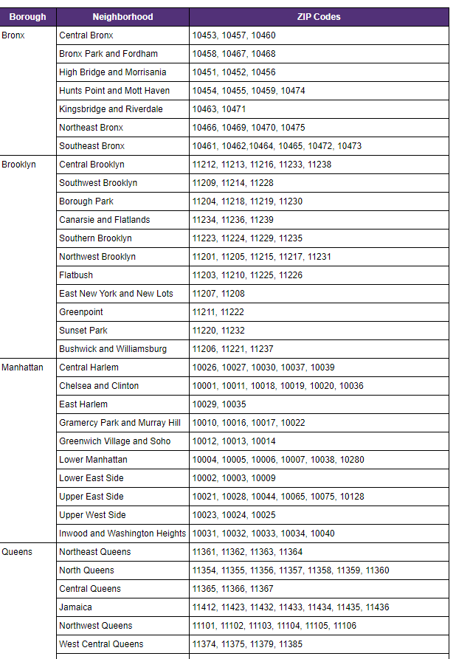
New York data example

Slide 5
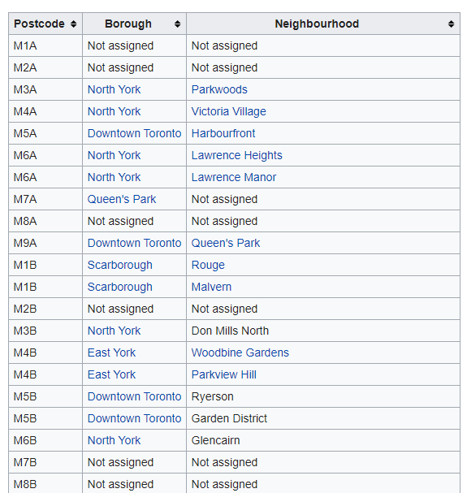
Toronto data example

Slide 6
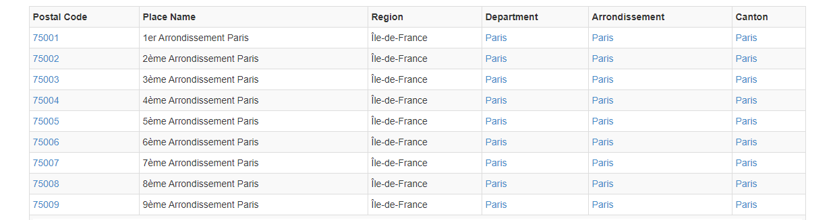
Paris data example

Slide 7
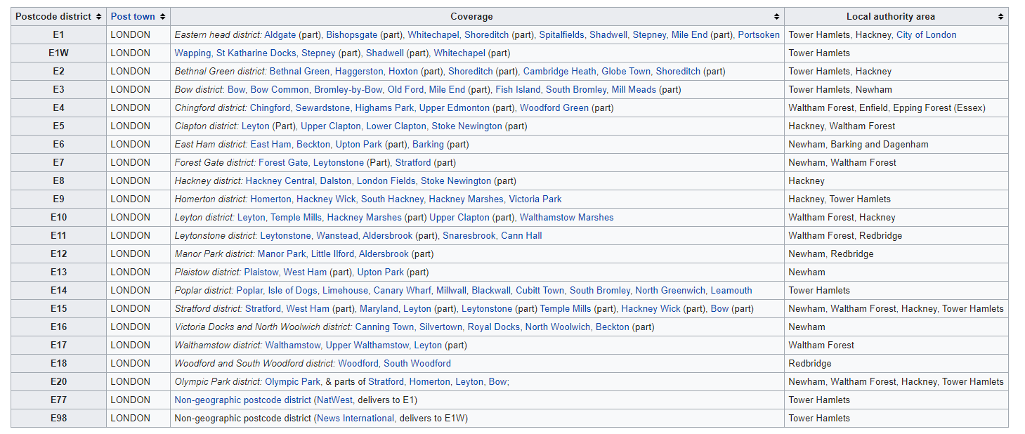
London data example (Eastern area)

Slide 8
methodology
I adopted the methodology used in Toronto example.
First i used read_html to read datasource para convert them to a datraframe. After that i did the transformations before convert them in a folium map, which means, drop duplicates, add columns, apend columns, etc. After that i created the folium map for each city based on latitude in pgeocode.nominatim.

Slide 9
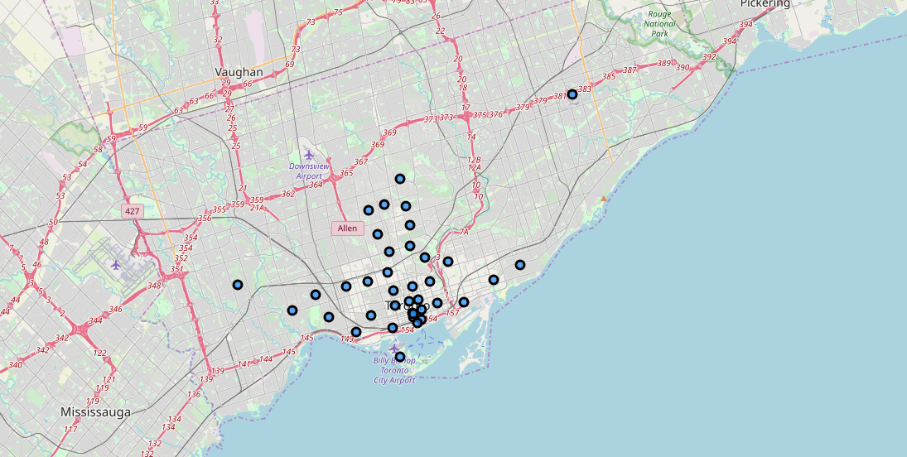
Toronto results

Slide 10
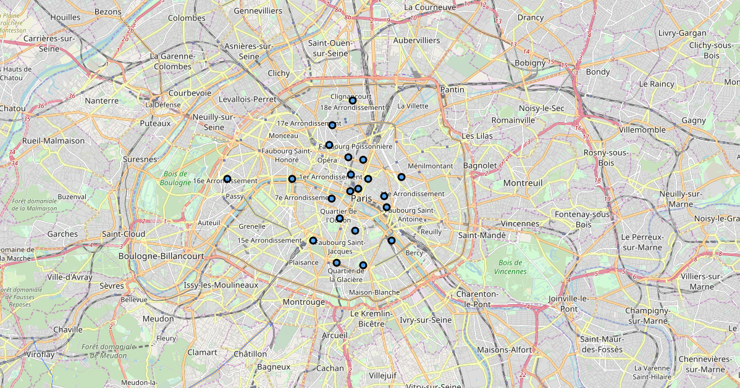
Paris results

Slide 11
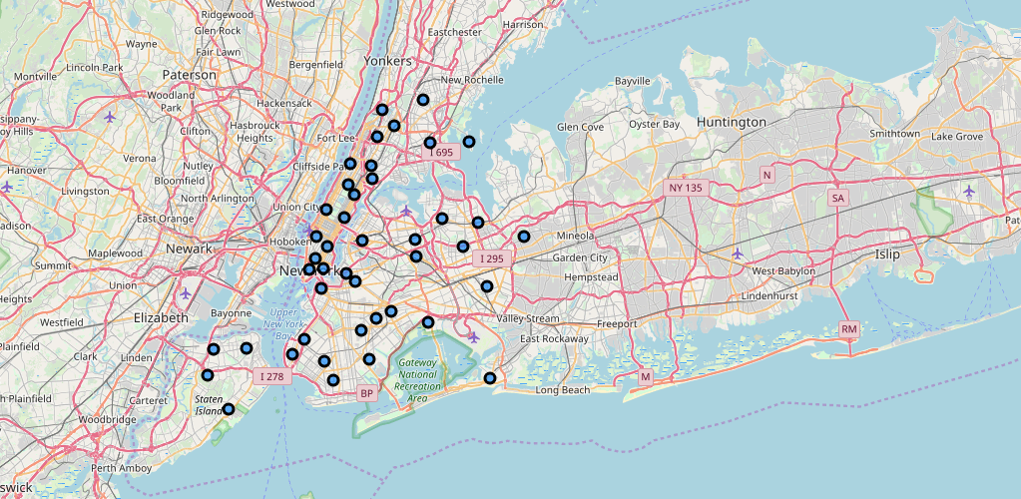
New York results

Slide 12
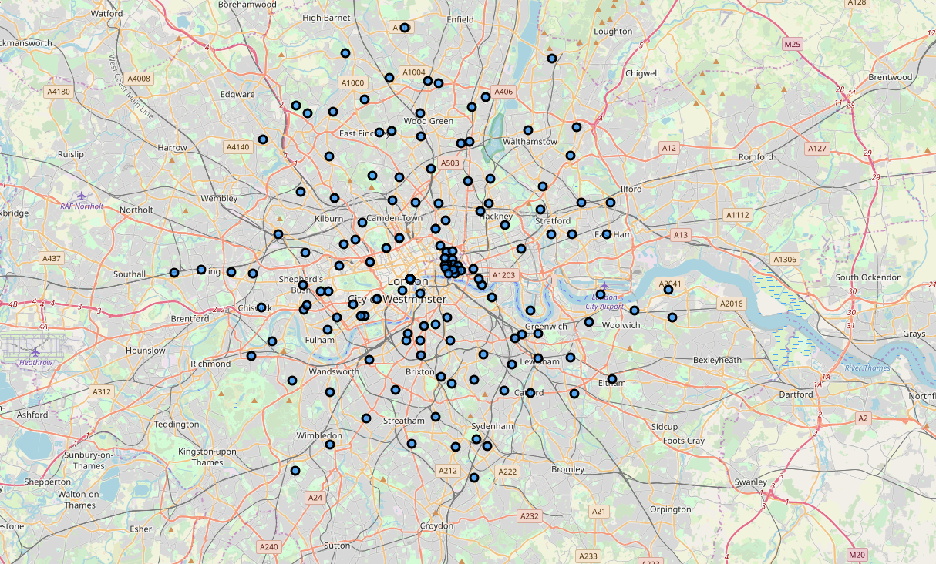
London results

Slide 13
conclusion
It was a cool project. I understand now better the concept of data transformation and data science. The course was amazing and i think that the know-how that i learned could be importance in my professional carreer.
Regarding of the project, i had no idea that the cities are so different.

